Slide 1
Machine Learning
AIML CZG565
M8 : Bayesian Learning
Course Faculty of M.Tech Cluster
BITS – CSIS - WILP

Slide 2

Machine Learning
Disclaimer and Acknowledgement
These content of modules & context under topics are planned by the course owner Dr. Sugata, with grateful acknowledgement to many others who made their course materials freely available online
We here by acknowledge all the contributors for their material and inputs.
We have provided source information wherever necessary
Students are requested to refer to the textbook w.r.t detailed content of the presentation deck shared over canvas
We have reduced the slides from canvas and modified the content flow to suit the requirements of the course and for ease of class presentation
Slide Source / Preparation / Review:
From BITS Pilani WILP: Prof.Sugata, Prof.Chetana, , Prof.Monali, Prof.Rajavadhana
External: CS109 and CS229 Stanford lecture notes, Dr.Andrew NG and many others who made their course materials freely available online

Slide 3
Course Plan
M1 | Introduction & Mathematical Preliminaries
M2 | Machine Learning Workflow
M3 | Linear Models for Regression
M4 | Linear Models for Classification
M5 | Decision Tree
M6 | Instance Based Learning
M7 | Support Vector Machine – Planned to be discussed in CS 15 or CS 16
M8 | Bayesian Learning
M9 | Ensemble Learning
M10 | Unsupervised Learning
M11 | Machine Learning Model Evaluation/Comparison

Slide 4
Text Classification using Naive Bayes Classifier

Slide 5
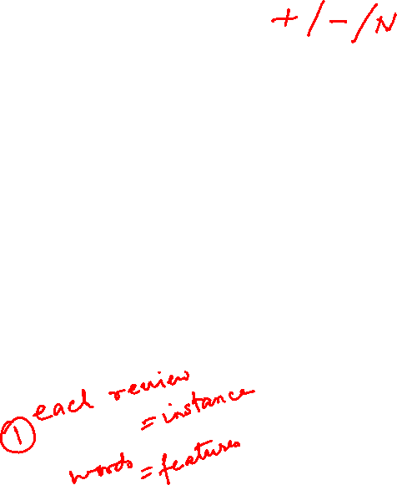
The Bag of Words Representation
it | 6
I | 5
the | 4
to | 3
and | 3
seen | 2
yet | 1
would | 1
whimsical | 1
times | 1
sweet | 1
satirical | 1
adventure | 1
genre | 1
fairy | 1
humor | 1
have | 1
great | 1
… | …
I love this movie! It's sweet, but with satirical humor. The dialogue is great and the adventure scenes are fun... It manages to be whimsical and romantic while laughing at the conventions of the fairy tale genre. I would recommend it to just about anyone. I've seen it several times, and I'm always happy to see it again whenever I have a friend who hasn't seen it yet!
fairy
it and
always love_{to} ^{it} whimsical it
I
seen
are
anyone
friend
happy
dialogue
adventure
recommend
satirical
_{who}sweet of _{movie}
it I
it ^{I} but ^{to} romantic
several
yet it
again
the
humor
the
seen
would
to scenes I
the manages
fun ^{the} times _{and}
I
and
about
whenever
have
while
conventions with

Slide 6
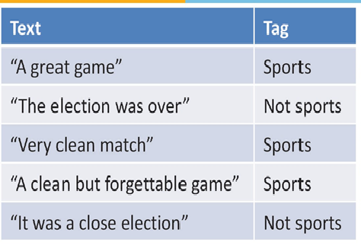
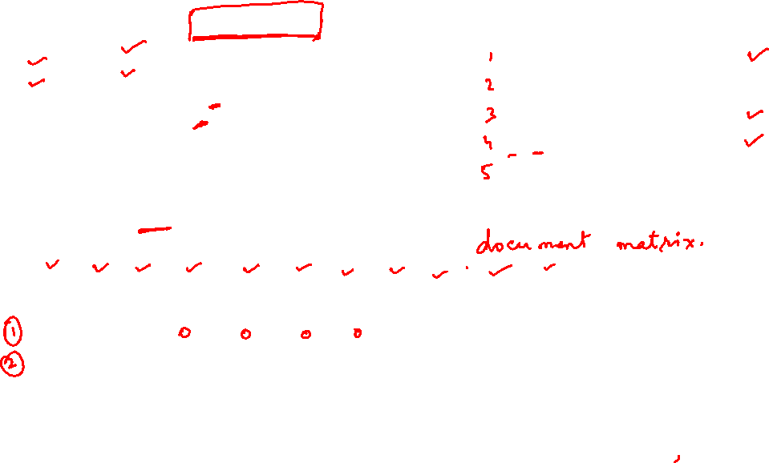
Example : Multinomial model :
Which Tag sentence “ A very close game” belong to?
P(Sports=Yes) = 3/5
P(Sports=No) = 2/5
P(A | Sports=Yes) = 2/11
P(A | Sports=No) = 1/9
P(Sports=Yes | X) = P(X | Sports=Yes). P(Sports=Yes) / P(X)
= P(X | Sports=Yes). (3/5)
= P(A| Sports=Yes). P(Very | Sports=Yes). P(Close | Sports=Yes). P(Game | Sports=Yes). (3/5)
= (2/11) . (1/11) . (0/11) . (2/11) . (3/5)
A | Great | Game | The | Election | Was | Over | Very | Clean | Match | But | Forgettable | It | Close | Sports or Not Sports
1 | 1 | 1 |  |  |  |  |  |  |  |  |  |  |  | 1
 |  |  | 1 | 1 | 1 | 1 |  |  |  |  |  |  |  | 0
 |  |  |  |  |  |  | 1 | 1 | 1 |  |  |  |  | 1
1 |  | 1 |  |  |  |  |  | 1 |  | 1 | 1 |  |  | 1
1 |  |  |  | 1 | 1 |  |  |  |  |  |  | 1 | 1 | 0
1 |  | 1 |  |  |  |  | 1 |  |  |  |  |  | 1 | ????

Slide 7
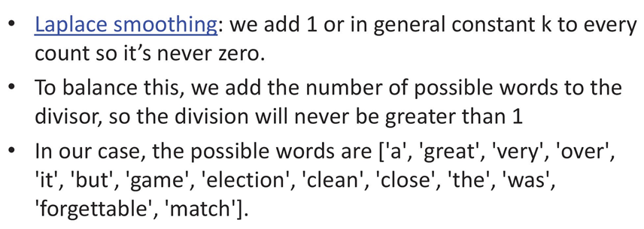
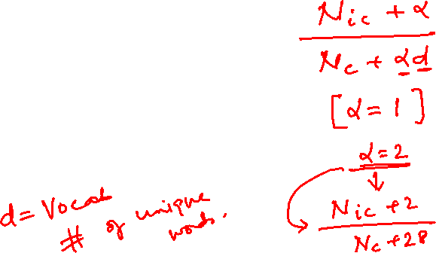
Laplace Smoothing
In our example
we add 1 to every probability, therefore the probability, such as P(close | sports), will never be 0.

Slide 8
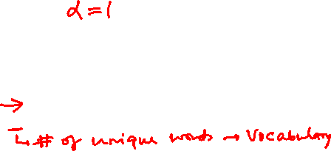
Example : Multinomial model :
Which Tag sentence “ A very close game” belong to?
P(Sports=Yes) = 3/5
P(Sports=No) = 2/5
P(A | Sports=Yes) = 2/11
P(A | Sports=No) = 1/9
P(Sports=Yes | X) = P(X | Sports=Yes). P(Sports=Yes) / P(X)
= P(X | Sports=Yes). (3/5)
= P(A| Sports=Yes). P(Very | Sports=Yes). P(Close | Sports=Yes). P(Game | Sports=Yes). (3/5)
= (2/11) . (1/11) . (0/11) . (2/11) . (3/5)
= (2+1/11+14) . (1+1/11+14) . (0+1/11+14) . (2+1/11+14) . (3/5) (3+14/5+28)
= 0.00002765 =0.00002396
A | Great | Game | The | Election | Was | Over | Very | Clean | Match | But | Forgettable | It | Close | Sports or Not Sports
1 | 1 | 1 |  |  |  |  |  |  |  |  |  |  |  | 1
 |  |  | 1 | 1 | 1 | 1 |  |  |  |  |  |  |  | 0
 |  |  |  |  |  |  | 1 | 1 | 1 |  |  |  |  | 1
1 |  | 1 |  |  |  |  |  | 1 |  | 1 | 1 |  |  | 1
1 |  |  |  | 1 | 1 |  |  |  |  |  |  | 1 | 1 | 0
1 |  | 1 |  |  |  |  | 1 |  |  |  |  |  | 1 | ????

Slide 9
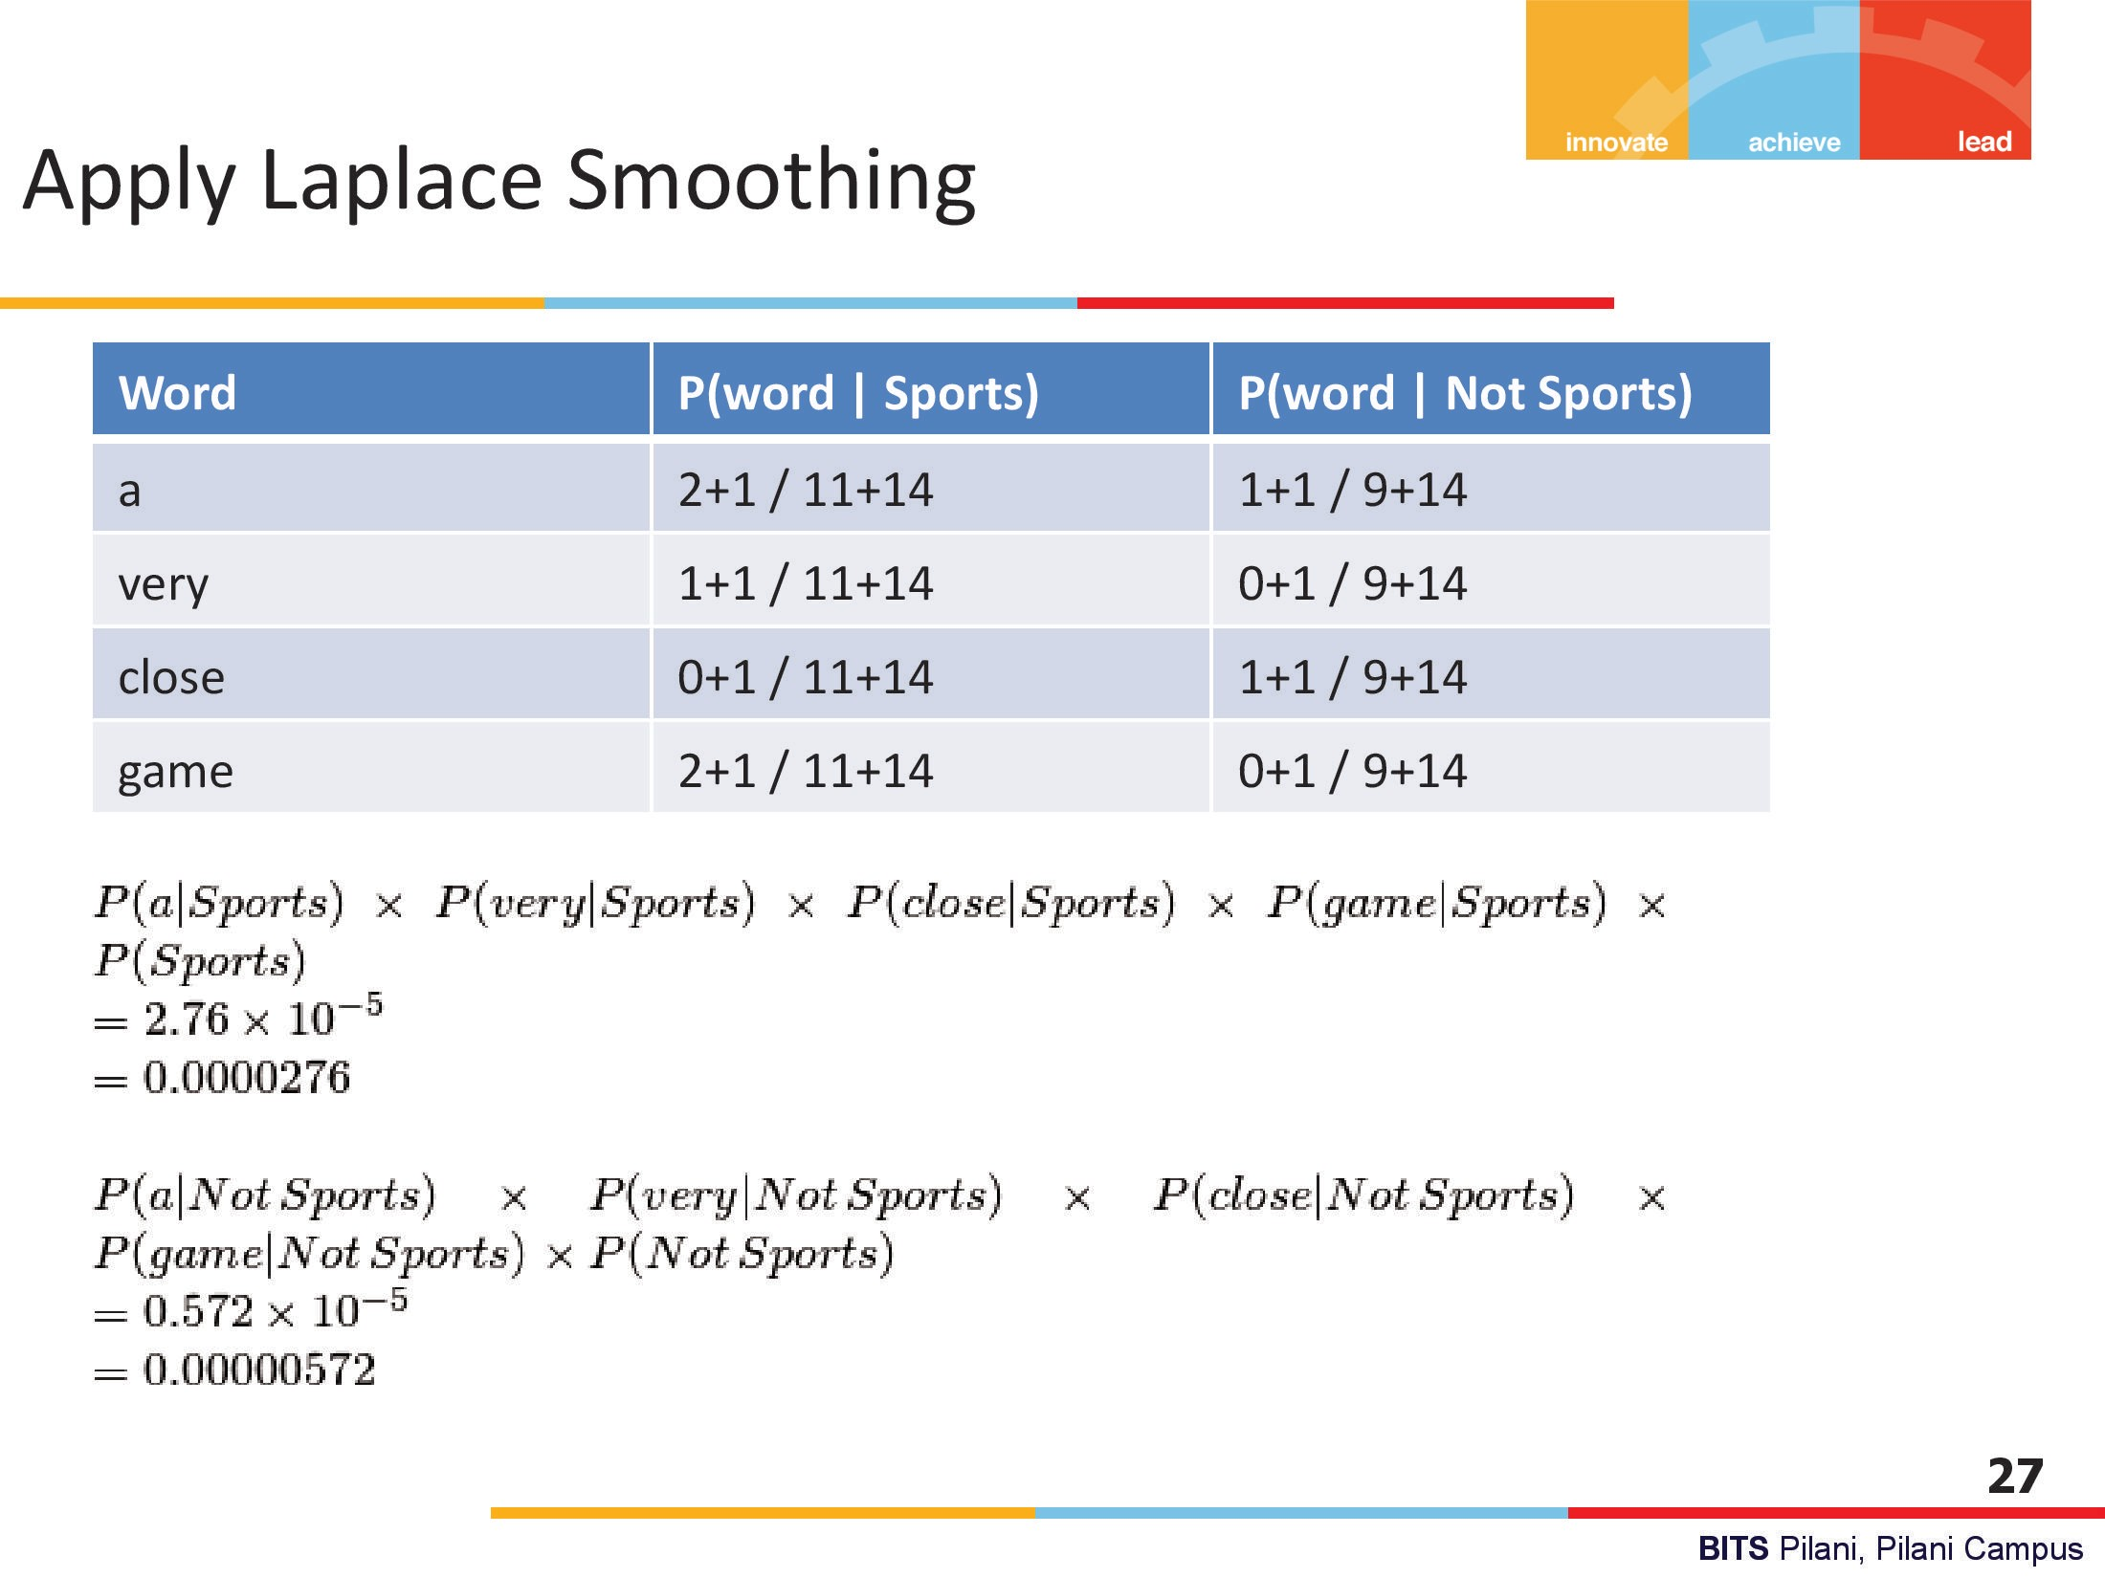


Slide 10
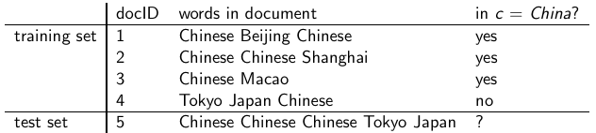
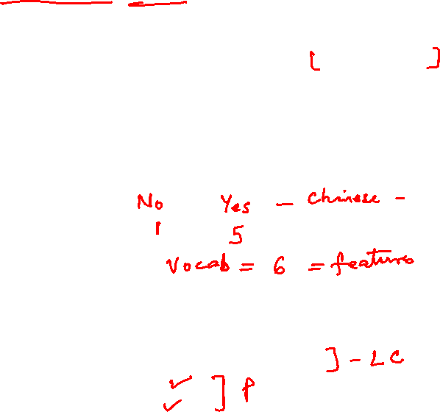
Example 2: Multinomial model
N_{yes} (W=Chinese) = 5, N_{No} (W=Chinese) = 1,
|v| = 6 = {Chinese, Beijing, Shanghai, Macao, Tokyo Japan}
No of features (words) in Yes class = 8
No of features (words) in No class = 3
Source Credit : https://nlp.stanford.edu/IR-book
10

Slide 11

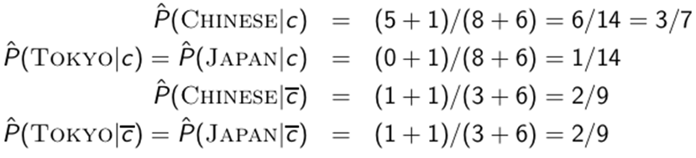
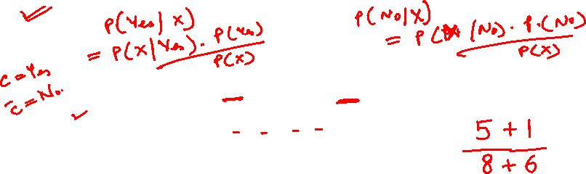
Example 2
Source Credit : https://nlp.stanford.edu/IR-book
11

Slide 12

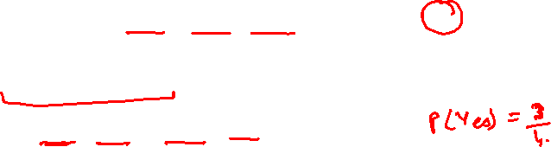
Example 2
u-each word in test document
Source Credit : https://nlp.stanford.edu/IR-book

Slide 13
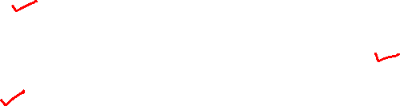
Naïve Bayes classifier: Summary Model
Model: joint probability distribution given by
  $P\left(X,Y\right)=P\left(Y\right) P\left(X | Y\right)$
  $P\left(X=X_{1}, ⋯,X_{n},Y=y_{k}\right)=P\left(Y=y_{k}\right) P(X=X_{1}, ⋯,X_{n}|Y=y_{k})$
Learning/Training:
For output variable Y
P($Y$) ~ Ber(p)
For each attribute X
$\text{P}\text{(}\text{X}\text{|}\text{Y}\text{)}\sim Ber\left(π\right) → Multivariate Bernoulli NB$ (X_{i} – binary)
P(X|Y)$\sim Multinom\left(π,n\right)$ $→ Multinomial NB$ (X_{i} – multinomial)
P(X|Y) ~ N(μ, σ²) $→ GaussianNB$ (X_{i} – real valued)
Source Credit : https://nlp.stanford.edu/IR-book

Slide 14
Logistic Regression vs Naïve Bayes
Idea:
Naïve Bayes allows computing P(Y|X) by learning P(Y) and P(X|Y)
Why not learn P(Y|X) directly?

Slide 15
Logistic Regression and
Gaussian Naïve Bayes Classifier
Interestingly, the parametric form of P(Y|X) used by Logistic Regression is precisely the form implied by the assumptions of a Gaussian Naive Bayes classiﬁer.
Therefore, we can view Logistic Regression as a closely related alternative to GNB, though the two can produce different results in many cases
Derivation given in CS-5 slides in self learning section and also attached PDF of new chapter from Tom Mitchell book

Slide 16
Features of Bayesian learning
Each observed training example can incrementally decrease or increase the estimated probability that a hypothesis is correct.
Flexible approach to learning than algorithms that completely eliminate a hypothesis if it is found to be inconsistent with any single example.

Slide 17
Practical Issues of Bayesian learning
Require initial knowledge of many probabilities
  Often estimated based on background knowledge, previously available data, and assumptions about the form of the underlying distributions.
Significant computational cost required to determine the Bayes optimal hypothesis in the general case (linear in the number of candidate hypotheses)

Slide 18
References
https://www.inf.ed.ac.uk/teaching/courses/inf2b/learnnotes/inf2b-learn07-notes-nup.pdf
https://cs229.stanford.edu/summer2019/cs229-notes2.pdf
Tom Mitchell – Chapter 6
https://nlp.stanford.edu/IR-book/pdf/13bayes.pdf

Slide 19
Logistic Regression & Naïve Bayes
Self Read
(Proof : Mathematical Relation between Logistic Regression and Naïve Bayes)

Slide 20
Where does the form come from?
Logistic regression hypothesis representation
$$h_{θ}\left(x\right)=\frac{1}{1+e^{−θ^{⊤}x}}=\frac{1}{1+e^{−(θ_{0}+θ_{1}x_{1}+θ_{2}x_{2}+⋯+θ_{n}x_{n})}}$$
Consider learning f: $X→Y$, where
  $X$ is a vector of real-valued features ${\left[X_{1}, ⋯,X_{n}\right]}^{⊤}$
  $Y$is Boolean
  Assume all $X_{i}$ are conditionally independent given $Y$
  Model $P\left(X_{i} | Y=y_{k}\right)$ as Gaussian $N\left(μ_{ik}, σ_{i}\right)$
  Model $P\left(Y\right)$ as Bernoulli $π$
What is $P\left(Y|X_{1},X_{2}, ⋯,X_{n}\right)$?

Slide 21
Where does the form come from?
$P\left(Y=1|X\right)=\frac{P\left(Y=1\right)P(X|Y=1)}{P\left(Y=1\right)P(X|Y=1) +P(Y=0)P(X|Y=0)}$
$=\frac{1}{1+\frac{P\left(Y=0\right)P(X|Y=0)}{P\left(Y=1\right)P(X|Y=1)}}$
$= \frac{1}{1+exp(ln⁡(\frac{P\left(Y=0\right)P(X|Y=0)}{P\left(Y=1\right)P(X|Y=1)} ))}$
$=$ $\frac{1}{1+exp(\ln\left(\frac{1−π}{π}\right)+\sum_{i}{ln} \frac{P(X_{i}|Y=0)}{P(X_{i}|Y=1)})}$
$$P\left(Y=1|X_{1},X_{2}, ⋯,X_{n}\right)=\frac{1}{1+exp(θ_{0}+\sum_{i}{θ_{i}}X_{i})}$$
Applying Bayes rule
Divide by $P\left(Y=1\right)P(X|Y=1)$
Apply $exp⁡(ln⁡(⋅))$
Plug in $P(X_{i}|Y)$
$$P\left(x|y_{k}\right)=\frac{1}{\sqrt{2π}σ_{i}}e^{−\frac{{\left(x−μ_{ik}\right)}^{2}}{2σ_{i}^{2}}}$$
$$\sum_{i}{(\frac{μ_{i0}−μ_{i1}}{σ_{i}^{2}}}X_{i}+\frac{μ_{i1}^{2}−μ_{i0}^{2}}{2σ_{i}^{2}})$$

Slide 22
Where does the hypothesis function come from?
Logistic regression hypothesis representation
P(Y=1|X) = $h_{θ}\left(x\right)=\frac{1}{1+e^{−θ^{⊤}x}}=\frac{1}{1+e^{−(θ_{0}+θ_{1}x_{1}+θ_{2}x_{2}+⋯+θ_{n}x_{n})}}$
  Model likelihood $P\left(X_{i} | Y=y_{k}\right)$ as Gaussian $N\left(μ_{ik}, σ_{i}\right)$ and assume variance is independent of class, i.e. σ_{i0} = σ_{i1} = σ_{i}
  Model prior $P\left(Y\right)$ as Bernoulli $π$ : P(Y=1) = π and P(Y=0) = 1-π
$$P\left(x|y_{k}\right)=\frac{1}{\sqrt{2π}σ_{i}}e^{−\frac{{\left(x−μ_{ik}\right)}^{2}}{2σ_{i}^{2}}}$$
What is $P\left(Y|X_{1},X_{2}, ⋯,X_{n}\right)$?

Slide 23



Logistic Regression –Bayesian Analysis
Applying Bayes rule
Divide by $P\left(Y=1\right)P(X|Y=1)$
Apply $exp⁡(ln⁡(⋅))$

Slide 24
Logistic Regression –Bayesian Analysis
By independence assumption:
P(Y=1)=π and P(Y=0)=1-π
by modelling P(Y) as Bernoulli

Slide 25
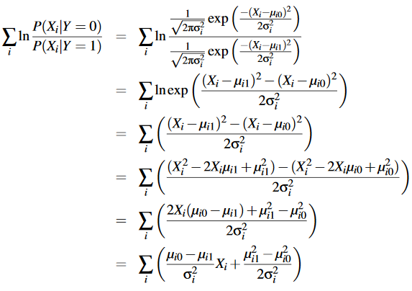




Logistic Regression –Bayesian Analysis
Plug in $P(X_{i}|Y)$

Slide 26
Some Additional References
T1 book by Tom Mitchell – Chapter-6
https://web.stanford.edu/class/archive/cs/cs109
https://cs229.stanford.edu/lectures-spring2022/main_notes.pdf
https://www.cs.cmu.edu/~ninamf/courses/601sp15/lectures.shtml
https://nlp.stanford.edu/IR-book - Chapter 13

Slide 27
Thank you !
Required Reading for completed session :
T1 - Chapter # 8 (Tom M. Mitchell, Machine Learning)
T1 - Chapter # 6 (Tom M. Mitchell, Machine Learning)
R1 – Chapter # 3 (Christopher M. Bhisop, Pattern Recognition & Machine Learning) & Refresh your MFDS & ISM parallel course basics
Next Session Plan :
Module 9 : Ensemble Learning

